Slide 1
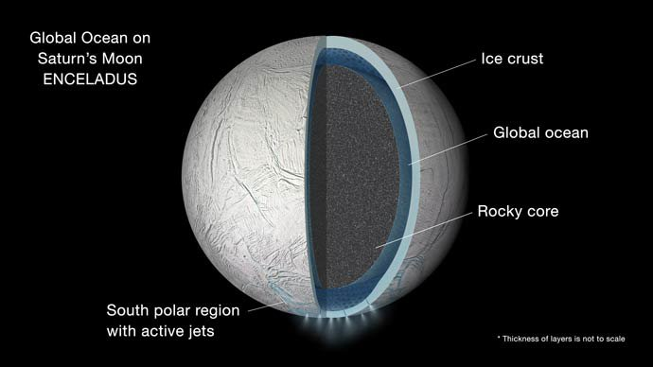
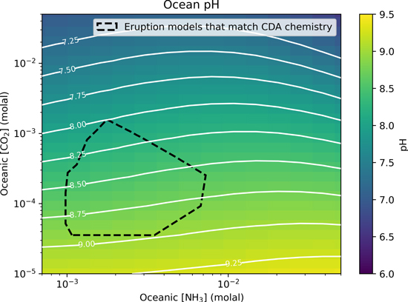
Astrobiology news this week…
New models from Fifer et al. (2022) indicate that the Europan ocean is moderately alkaline with a pH between 7.95 and 9.05. In addition, the authors believe that concentrations of carbon dioxide and hydrogen in the ocean would be sufficient to support hydrogenotrophic methanogens.

Slide 2
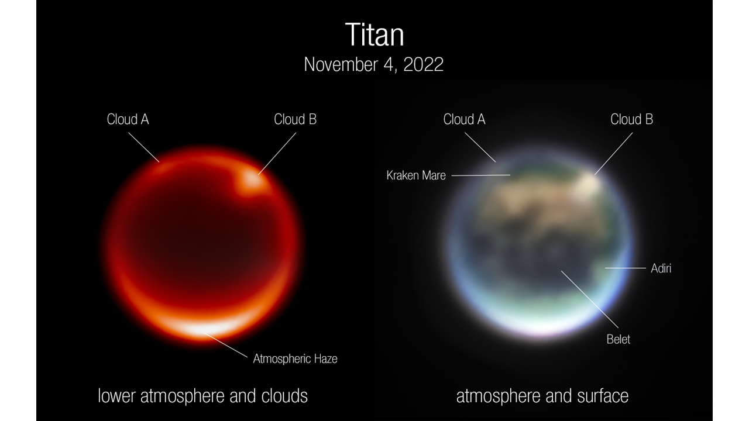
Astrobiology news this week…
Images of Saturn’s moon Titan, captured by JWST’s NIRCam instrument Nov. 4, 2022 (released 1 December 2022).
Left: Image using F212N, a 2.12-micron filter sensitive to Titan’s lower atmosphere. The bright spots are prominent clouds in the northern hemisphere. Right: Color composite image using a combination of NIRCam filters: Blue=F140M (1.40 microns), Green=F150W (1.50 microns), Red=F200W (1.99 microns), Brightness=F210M (2.09 microns). Several prominent surface features are labelled: Kraken Mare is thought to be a methane sea; Belet is composed of dark-colored sand dunes; Adiri is a bright albedo feature

Slide 3
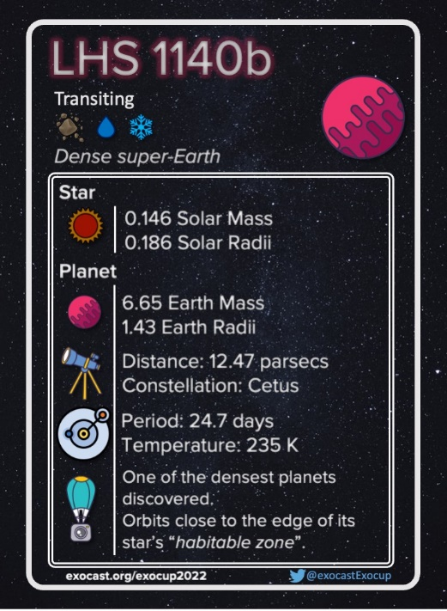
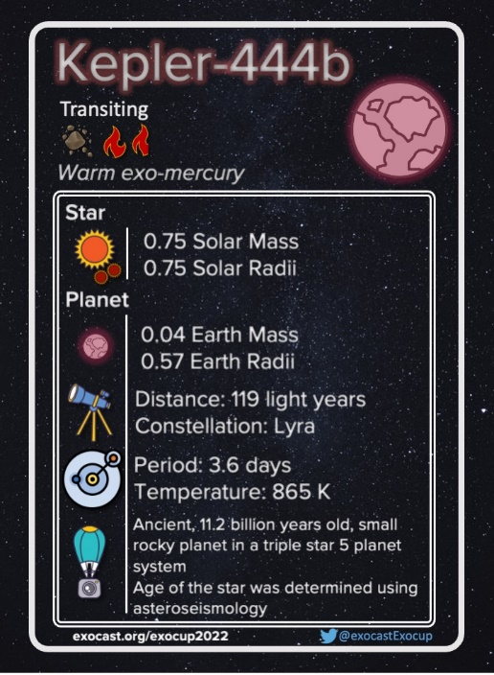
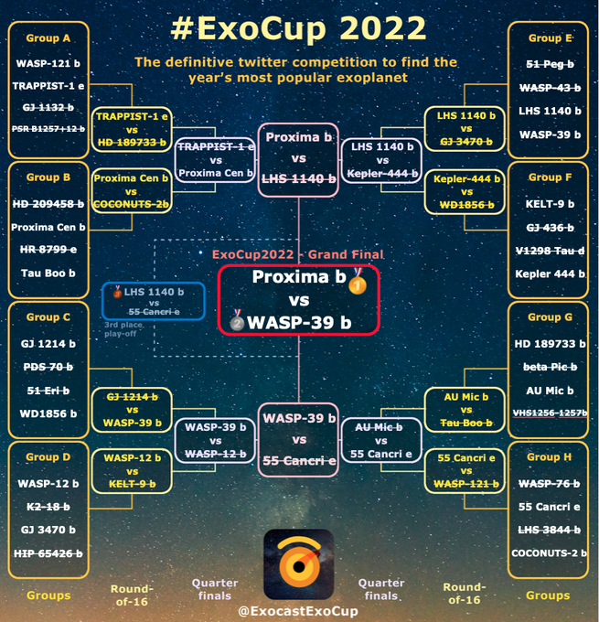
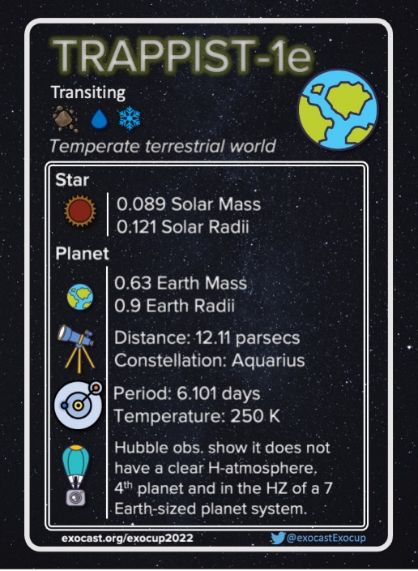
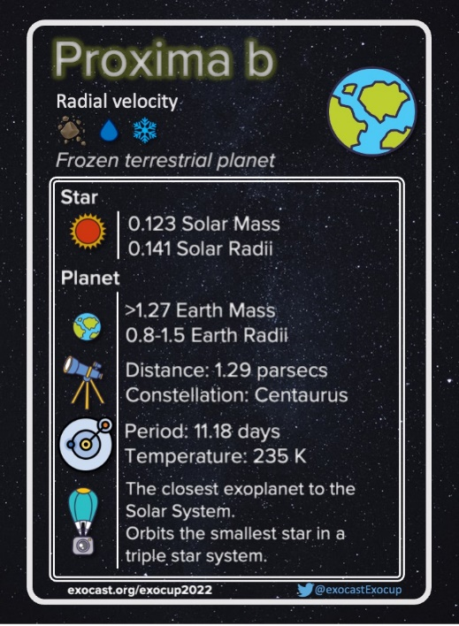
#ExoCup2022 – Proxima Centauri b wins!

Slide 4
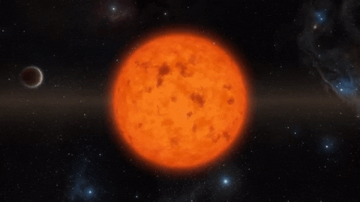
Exoplanets: Planets Orbiting Other Stars

Slide 5
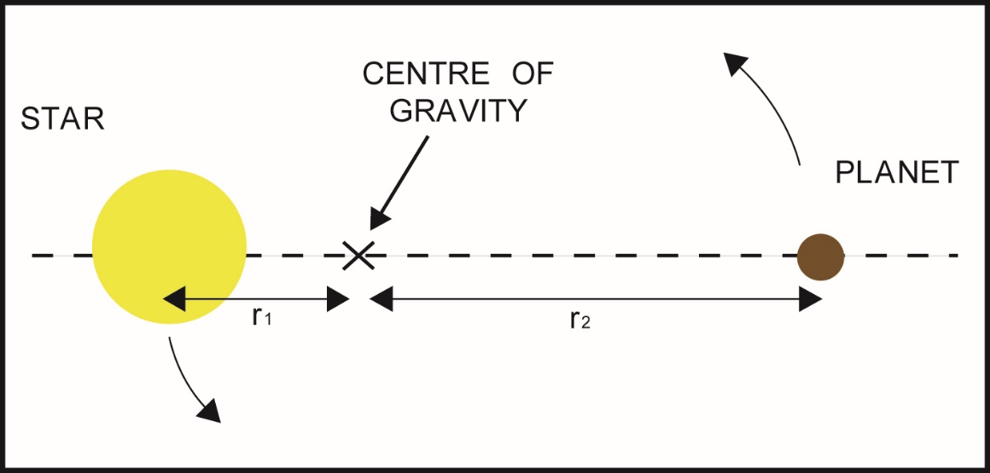
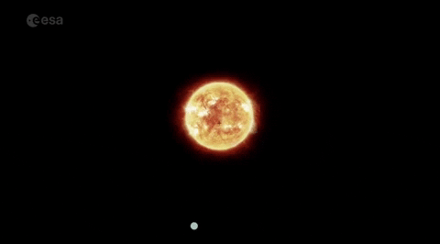
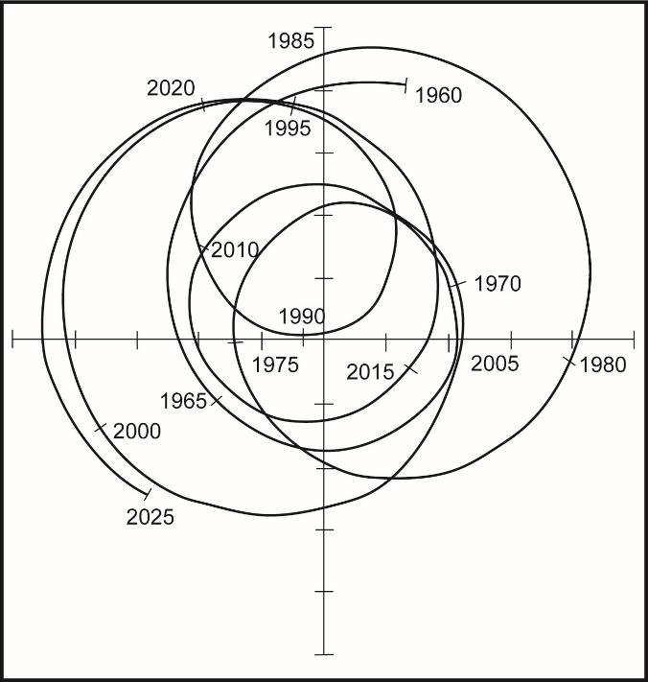
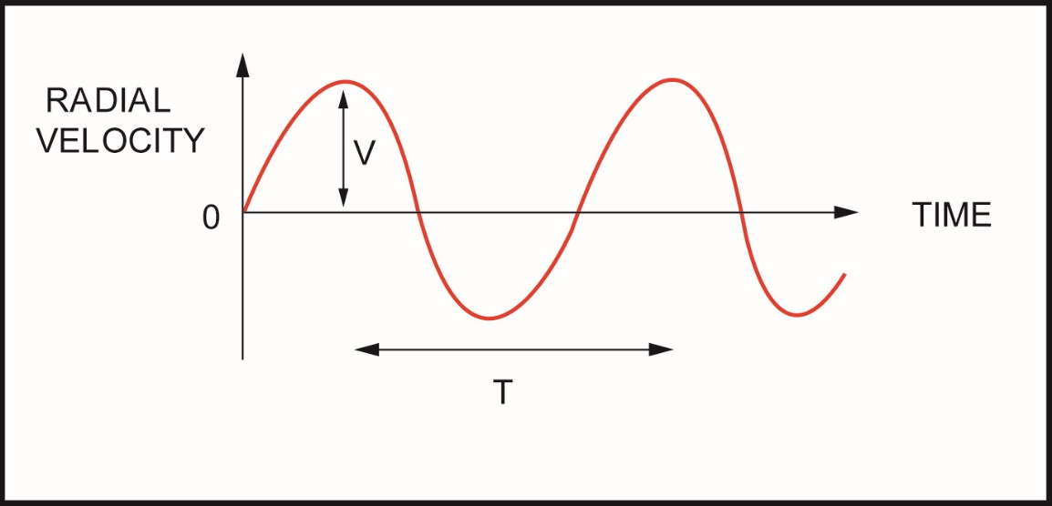
Detection
Astrometry
Radial velocity
10⁻⁶ degree
BACK TO
TEXT

Slide 6
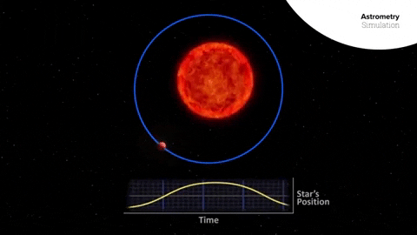
Astrometry

Slide 7
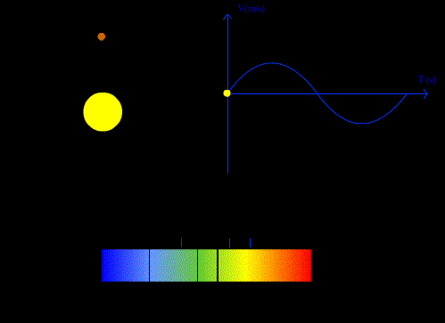
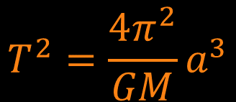
Radial velocity
Kepler’s 3rd Law
$$T^{2}=\frac{4π^{2}}{GM}a^{3}$$
Credit: Hannah Wakeford

Slide 8
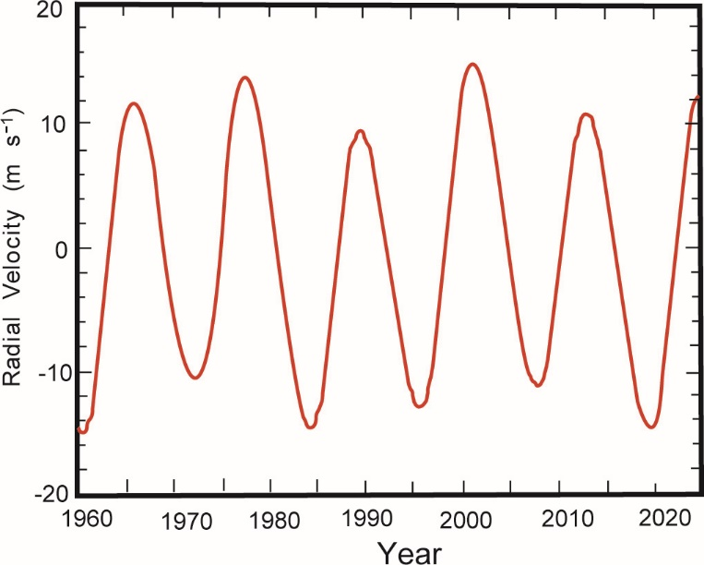
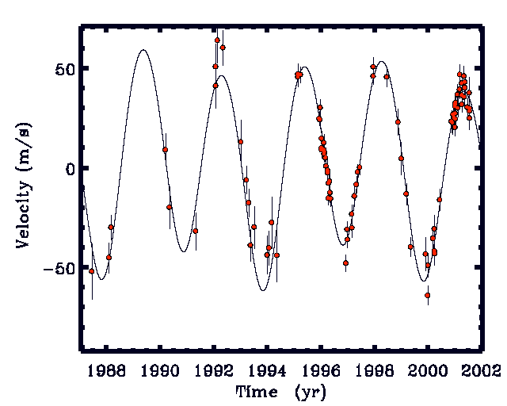
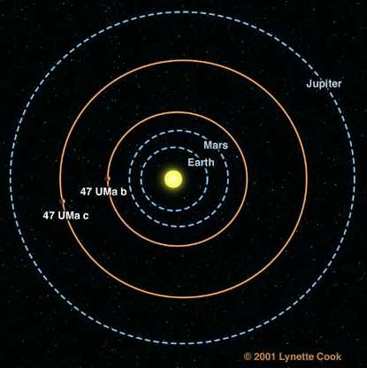
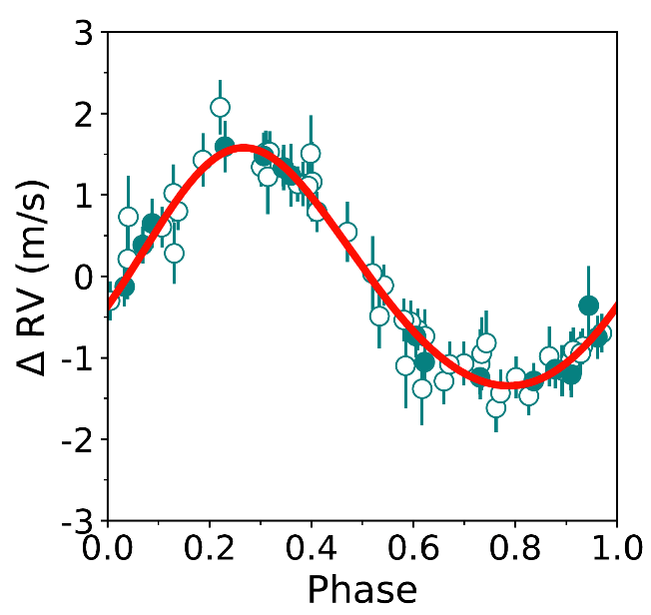
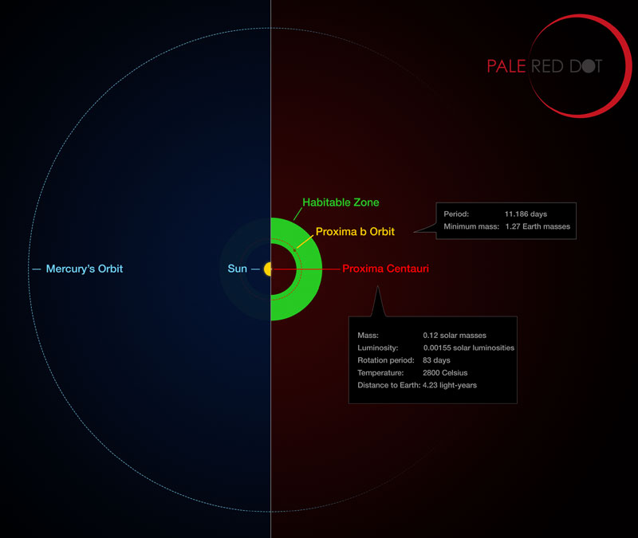
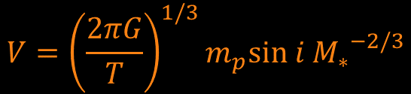
Radial velocity
RV curve of 47 Ursa Majoris
BACK TO
TEXT
RV curve of the Sun
RV curve of Proxima Centauri
Radial Velocity Amplitude
$$V={\left(\frac{2πG}{T}\right)}^{1/3}{m_{p}sin i M_{∗}}^{−2/3}$$
Plausible metabolisms:
4H₂ + CO₂ → CH₄ + 2H₂O
(methanogenesis)
4H₂ + 2CO₂ → CH₃COOH + 2H₂O
(acetogenesis)

Slide 9
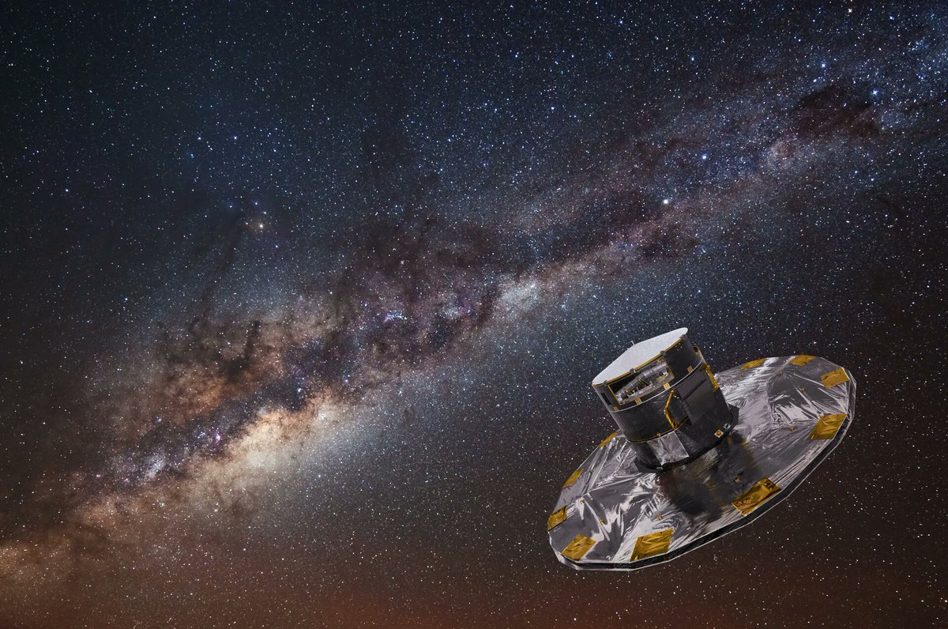
Radial velocity
ESA Gaia
Located at Sun-Earth L2 (1.5 million km)
Measurement precision: 7µas (2 x 10⁻⁹ degree)

Slide 10
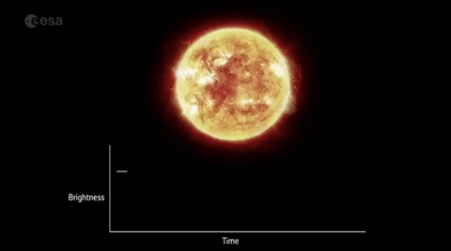
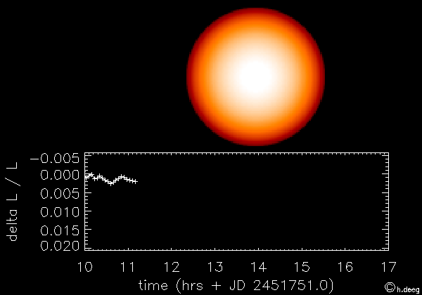
Transit photometry

Slide 11
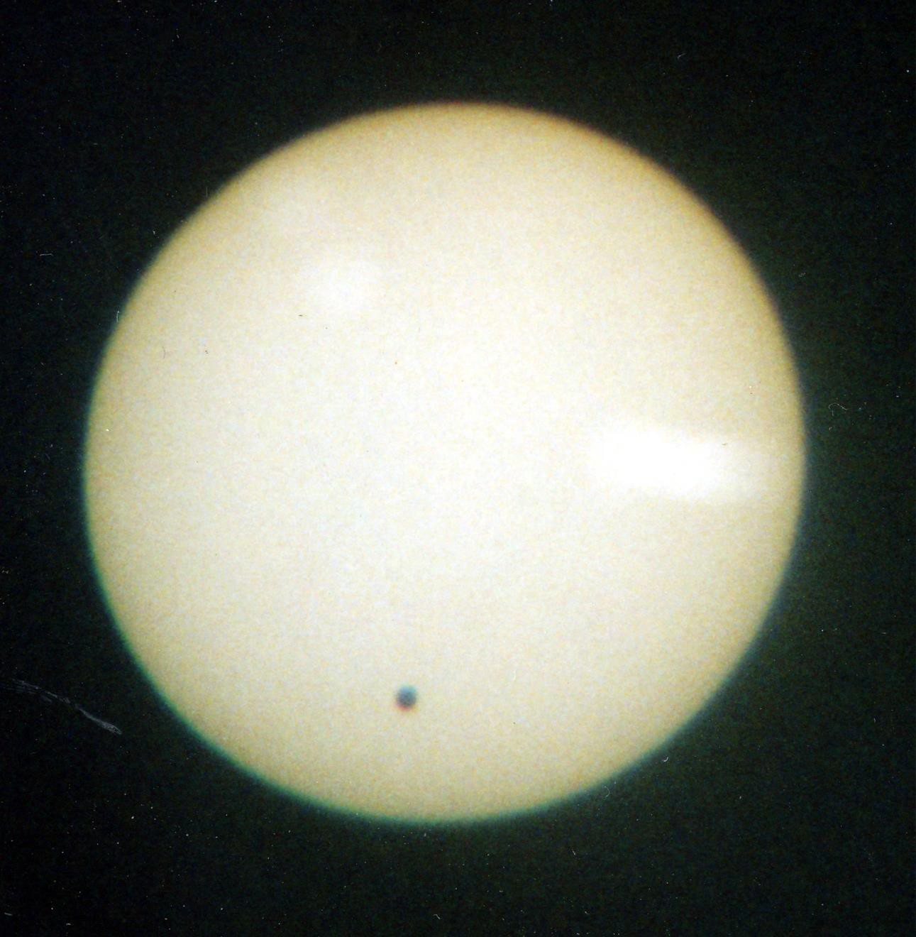

Slide 12
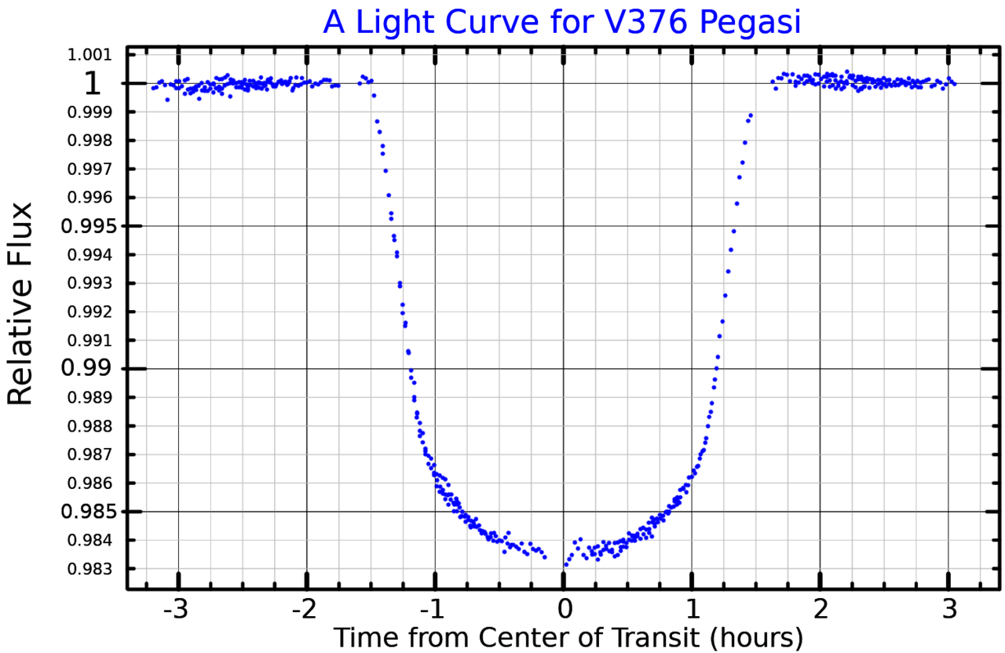
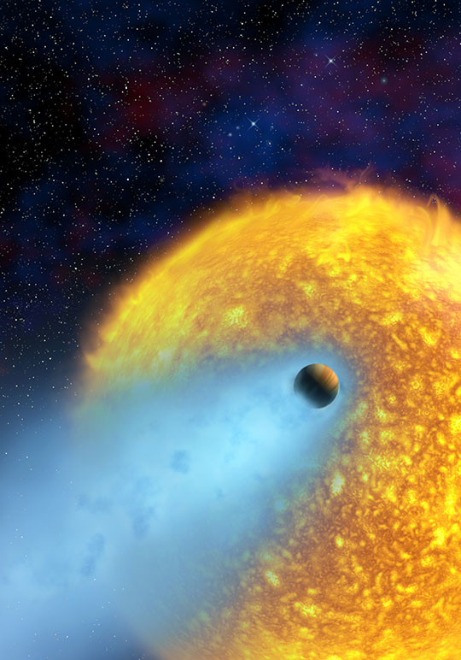
Transit photometry
The observed light curve of HD 209458 as its planet passes in front. The star dims by 1.5% during each transit, which lasts for 0.12 days (i.e. 2.9 hours). The transits repeat every 3.5 days
Astronomers estimate the amount of hydrogen gas escaping HD 209458b to be at least 10,000 tonnes per second

Slide 13


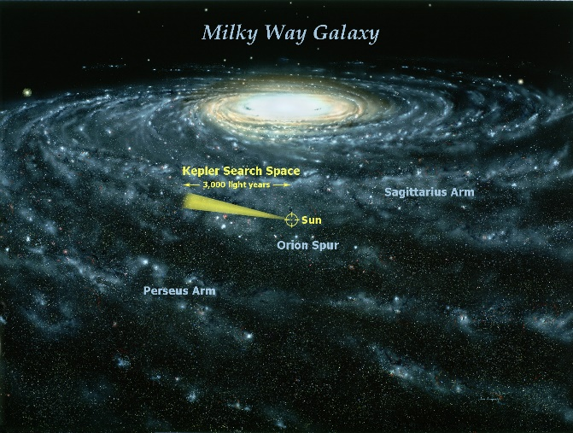
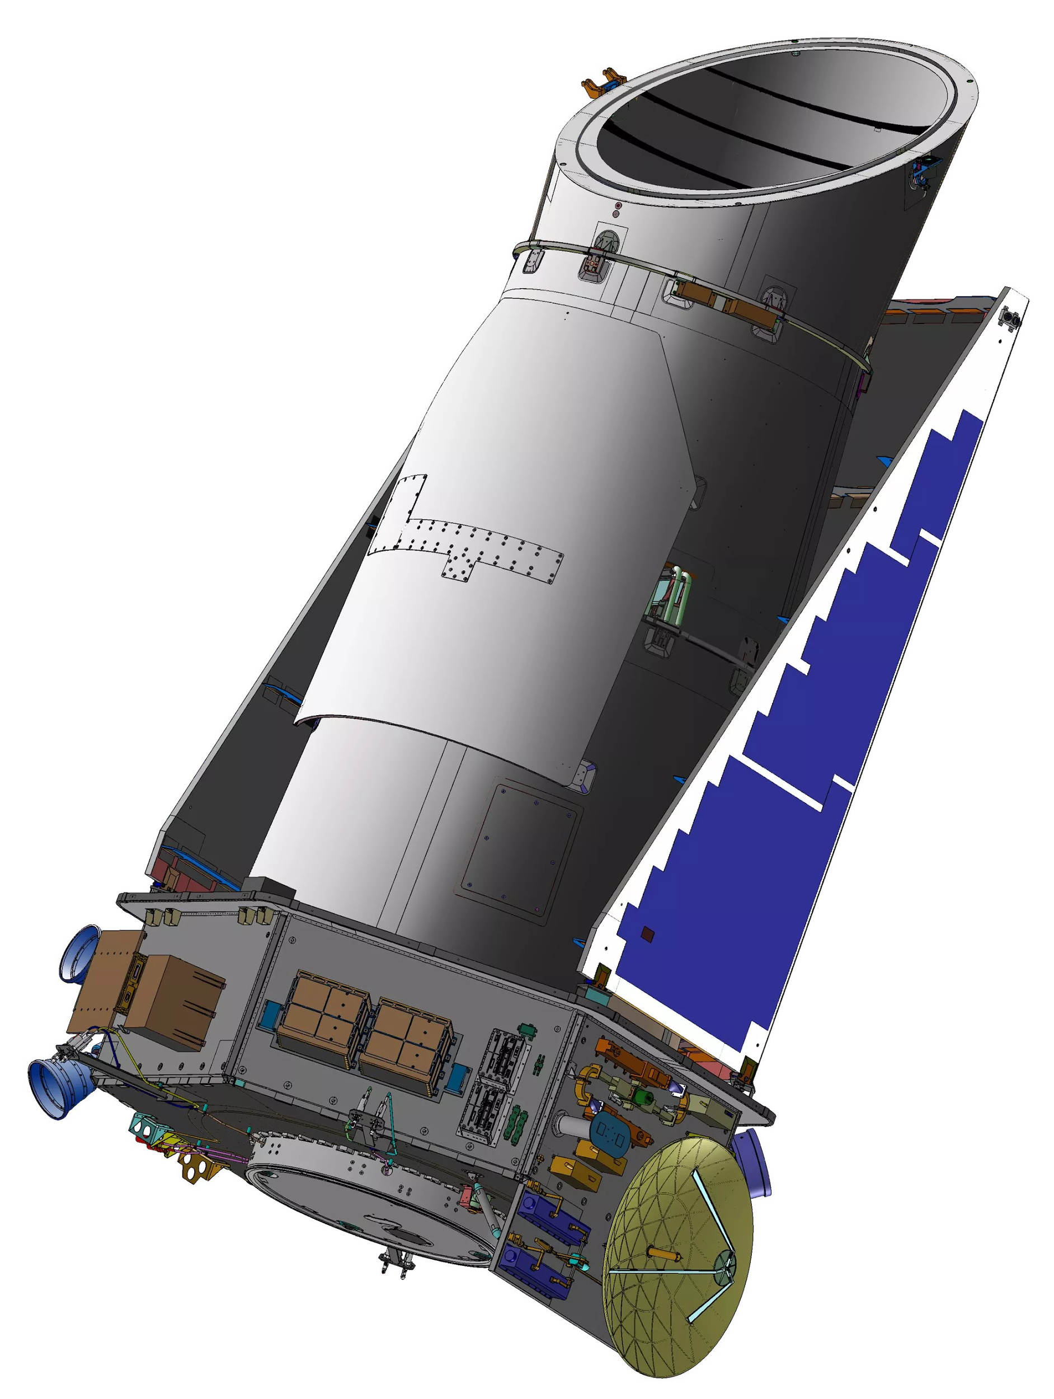
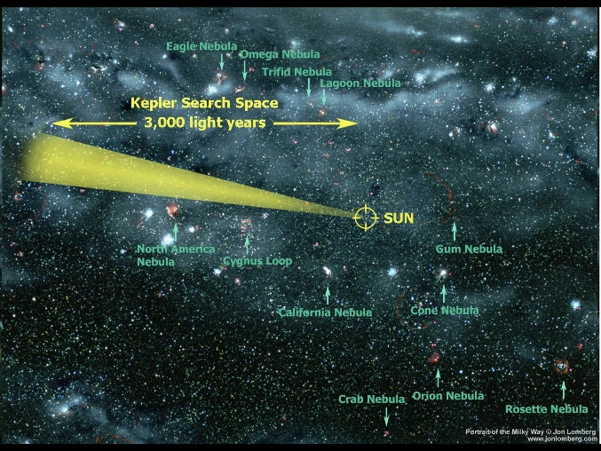
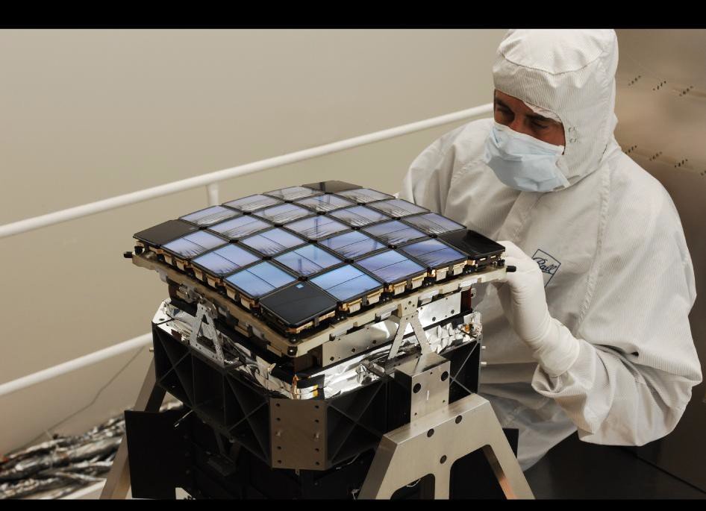
Launched March 2009
“…specifically designed to survey a portion of our region of the Milky Way galaxy to discover dozens of Earth-size planets...”
Light from distant stars
SCIENCE!

Slide 14
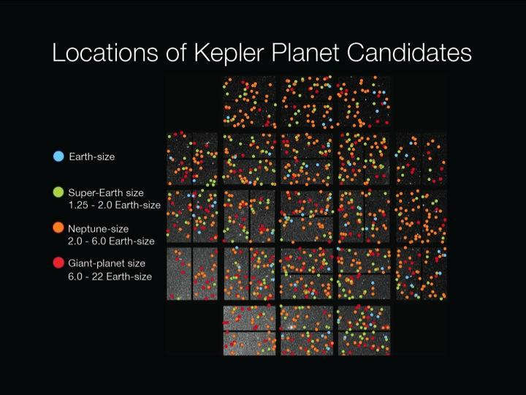
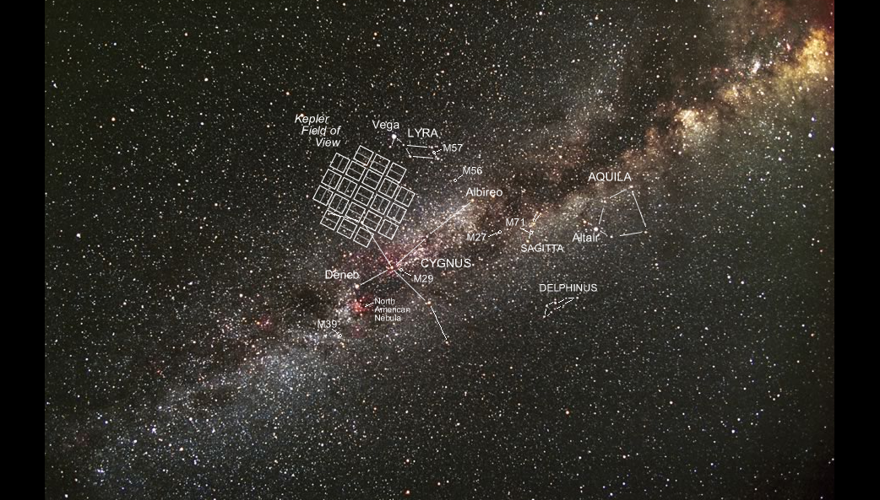
The Kepler field of view superimposed on the night sky.

Slide 15
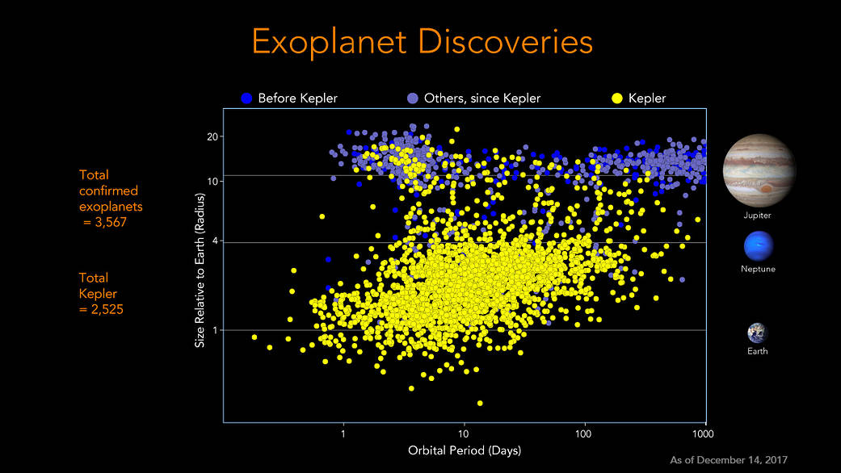

Slide 16
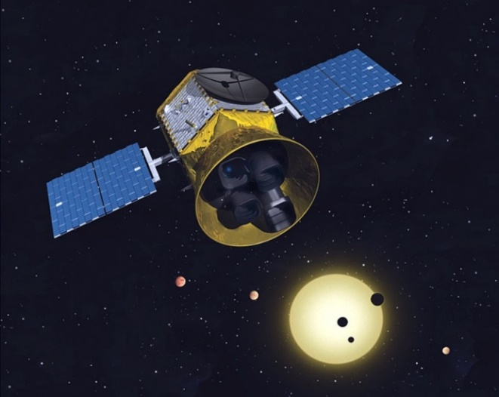
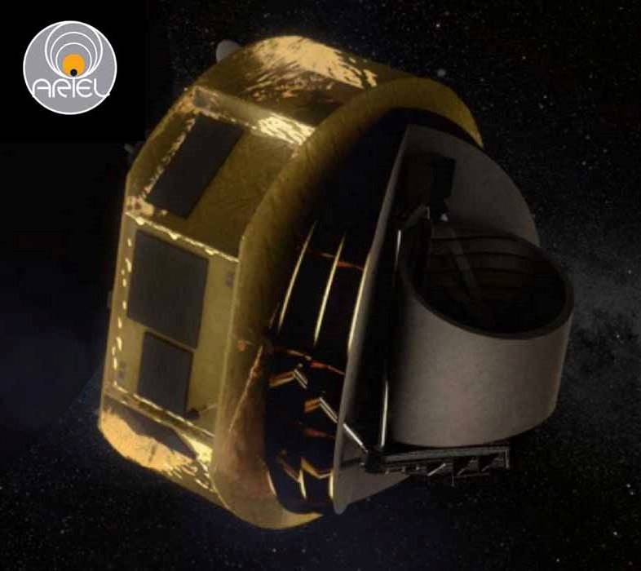
Post-Kepler
NASA TESS
ESA Ariel

Slide 17
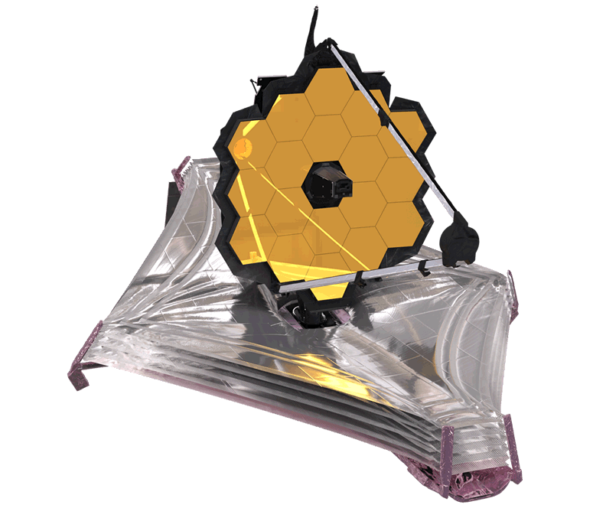

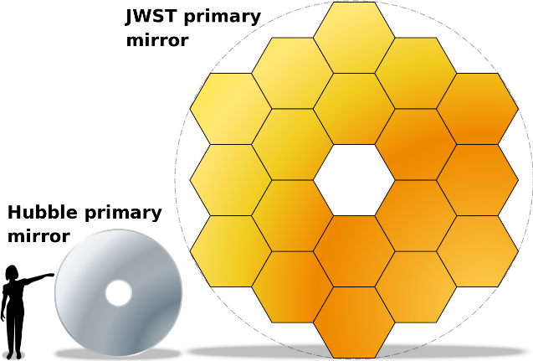
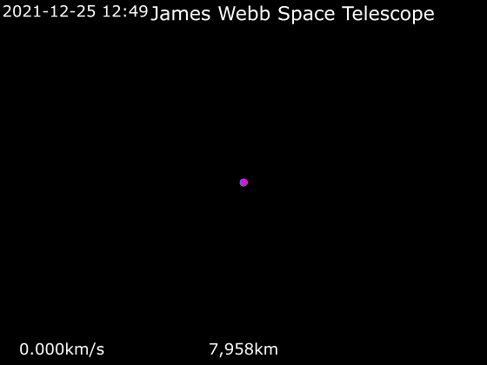
JWST
Conception: 1996-ish
Launched (finally): 25 December 2021
Located at Sun-Earth L2 point
6.5 m primary mirror (comparted to HST’s 2.4 m)
Observes in a lower frequency range compared to HST, from visible light (red) through mid-infrared (0.6–28.3 μm).

Slide 18
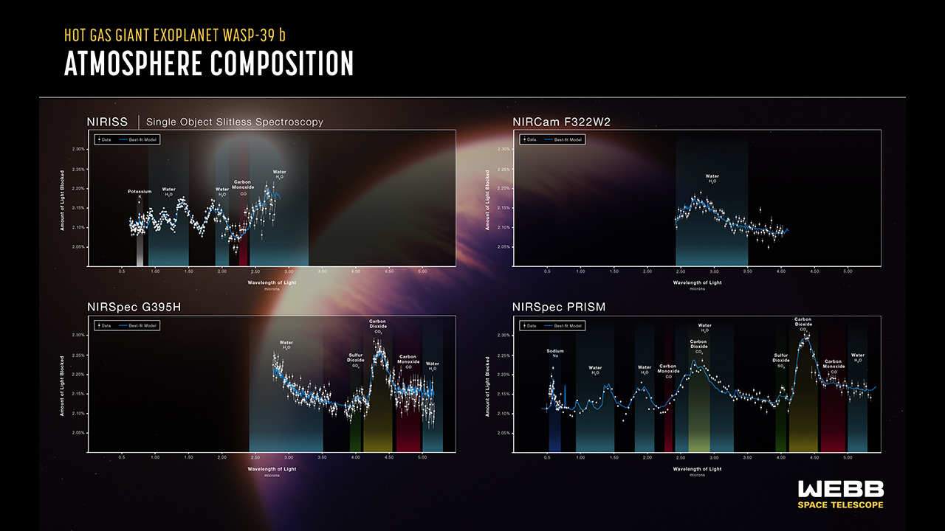
JWST

Slide 19
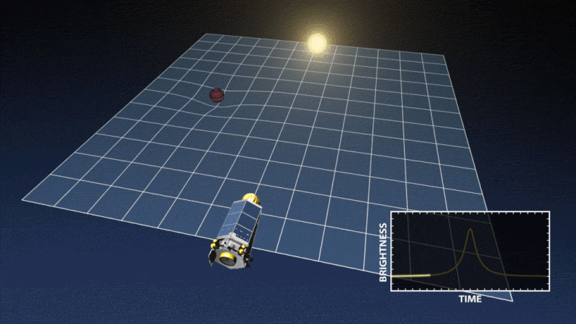
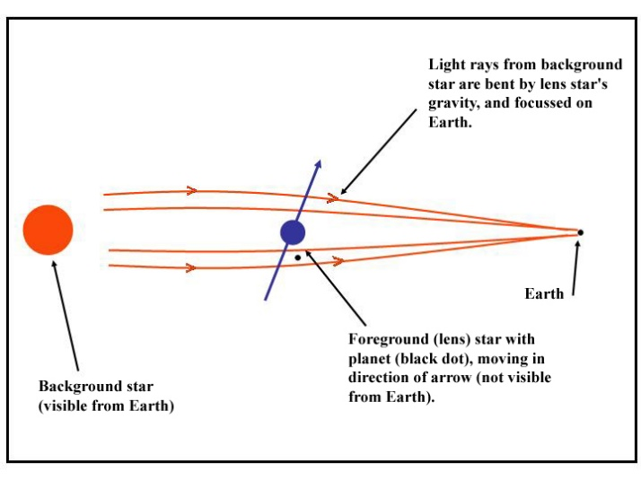
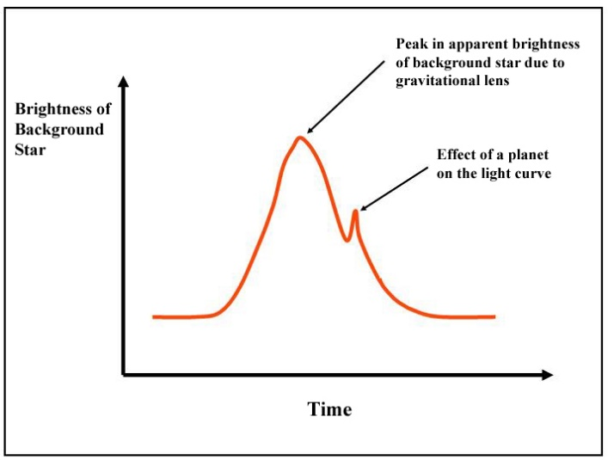
Gravitational Microlensing

Slide 20
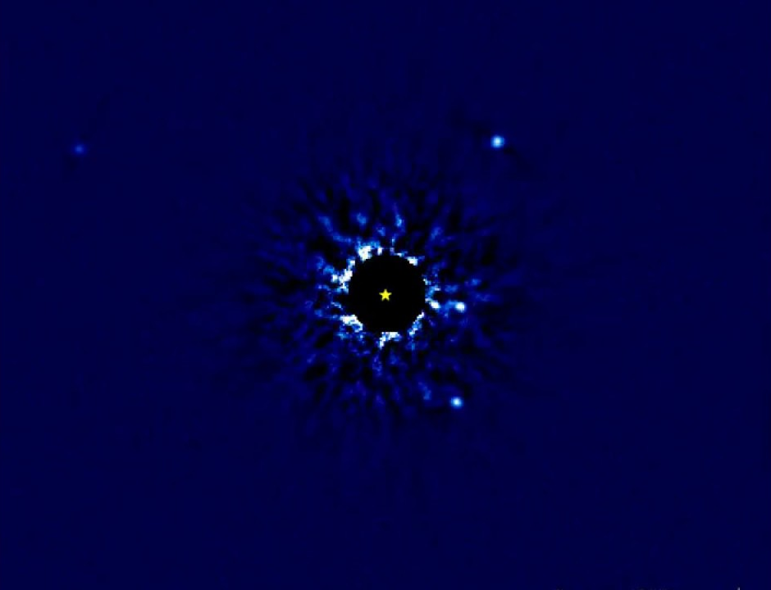
Direct Imaging of Exoplanets
HR 8799 hosts four ‘super-Jupiter’ planets with orbital periods ranging from decades to centuries (Wang, 2017)

Slide 21
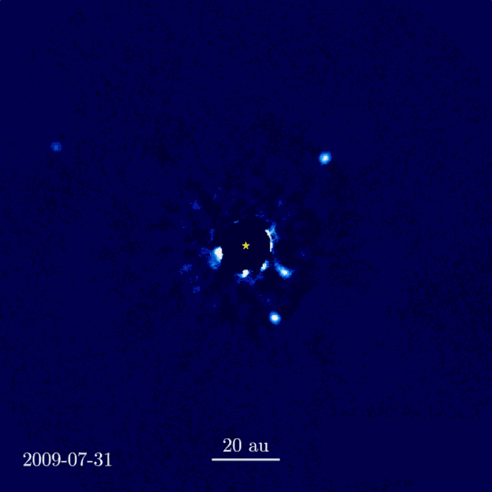
Direct Imaging of Exoplanets
HR 8799 hosts four ‘super-Jupiter’ planets with orbital periods ranging from decades to centuries (Wang, 2017),

Slide 22
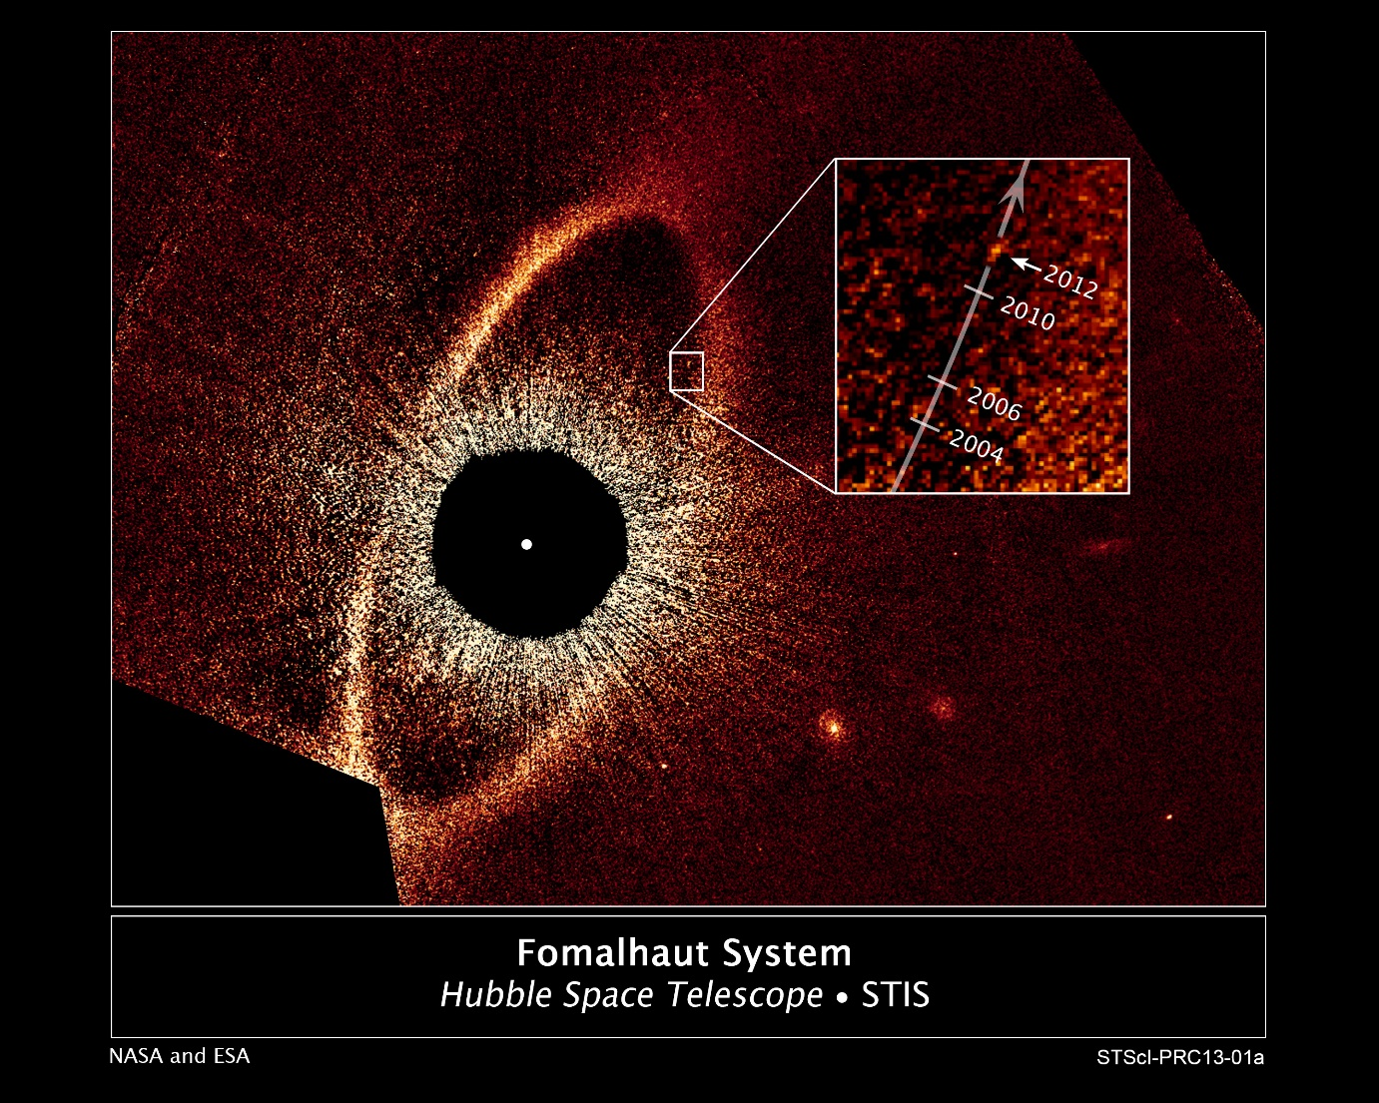
Direct Imaging of Exoplanets
FOMALHAUT B (Hubble Space Telescope) 2,000-year-long, highly elliptical orbit (NASA, ESA, and P. Kalas)

Slide 23
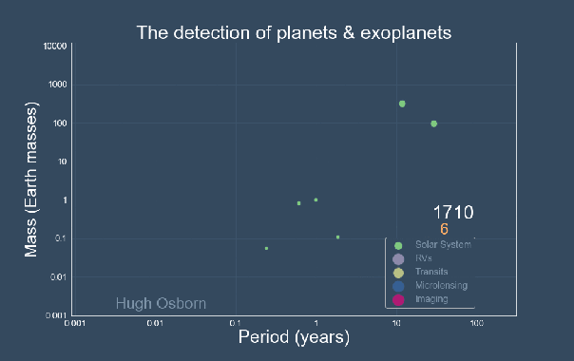
Exoplanet Population
Credit: Hugh Osborn

Slide 24
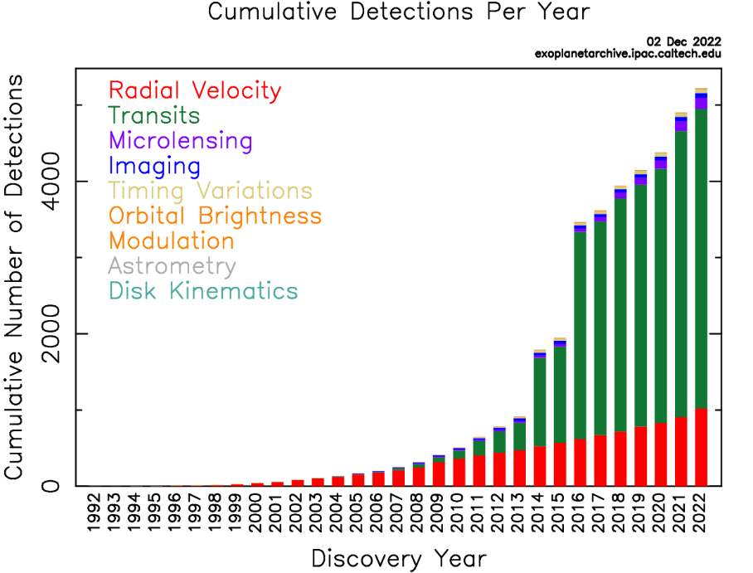
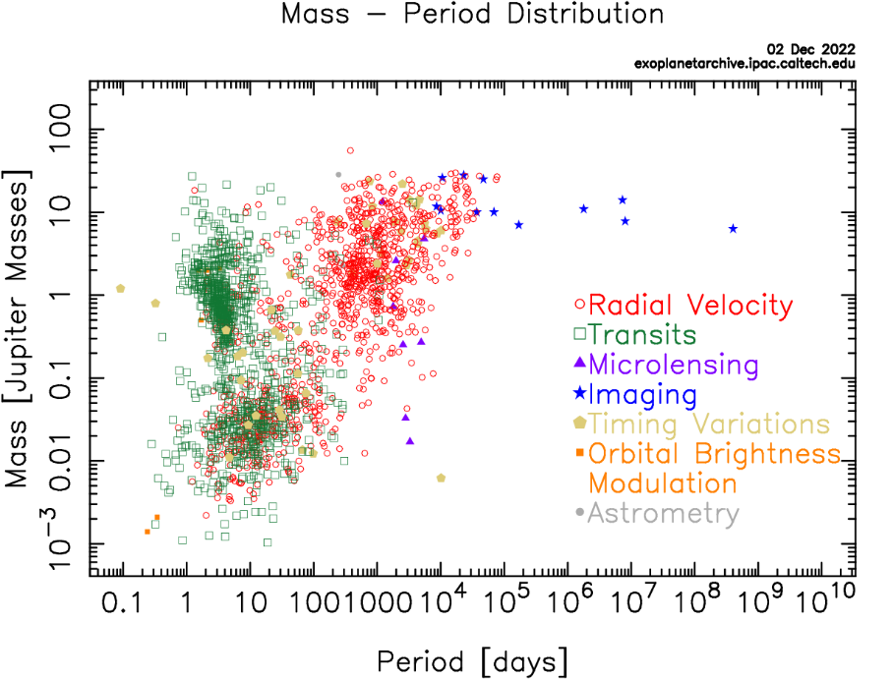


Exoplanet Population (Dec 2022)

Slide 25

Host-Star Exoplanet Population

Slide 26


Slide 27

Searching for Life
CHZ

Slide 28
Searching for Life
CHZ

Slide 29



The Habitable Zone
The distance from a star where:
Delicious liquid water exists…
…on the surface of a planet…
…with an atmosphere and composition like the Earth.
Habitable Zone
*Kasting et al. (1993) – Icarus; Kopparapu et al., (2013) - ApJ
not to scale

Slide 30


Habitability in Time

Slide 31

Searching for Life
TRAPPIST 1

Slide 32

Searching for Life
TRAPPIST 1

Slide 33

Searching for Life
TRAPPIST 1

Slide 34


Searching for Life
TRAPPIST 1
Artists’ conception of TRAPPIST-1 system

Slide 35


Searching for Life
(a)
(b)
(c)

Slide 36

Biosignatures

Slide 37


Biosignatures
Reflectance spectrum (earthshine) features multi- and hyperspectral absorption features of atmospheric components.
Sagan et al. (1993) - Nature

Slide 38

Biosignatures
Kiang et al. (2007)

Slide 39


Biosignatures
Meadows et al. (2018)

Slide 40

Fujii et al. (2018)

Slide 41

Future Prospects
Fujii et al. (2018)

Slide 42

Fujii et al. (2018)

Slide 43


signatures

Slide 44

signatures

Slide 45

Examples of Technosignatures
Radio Signals
Low frequency radiation in the 1.4 and 1.7 GHZ range, known as the ‘cosmic watering hole’ as it covers the natural frequencies of the hydroxyl radical and hydrogen, has been proposed as a possible frequency to start looking¹ and broadcasting.
Optical Signals
Infrared to ultraviolet radiation, including laser emissions. Intentional directed attempts at communication, or pollution/infrared excess from light sail propulsion (e.g. The Planetary Society’s LightSail I and II). Chromatic cloaking to intentionally swamp the transmission spectrum of a planet to obscure evidence of oxygen, pollutants, & bio- or technosignatures¹.
Mirrors & Megastructures
On orbit mirrors for planetary terraforming e.g. Venus², or in response to climate change, or to direct stellar radiation for power generation. We could find them when the planet is in transit. Other structures include the hypothetical Dyson sphere – a hypothetical means of capturing the entire radiative output of the star for power generation³ – requires highly advanced technology.
Neutrinos
Neutrinos propagate through space and rarely interact with normal matter. Advanced technology could hypothetically leverage this property to communicate over astronomical distances⁴.
Complex molecules in the atmosphere
Industrially-produced complex molecules emitted into the atmospheres of planets would produce complex band-structures in spectroscopic surveys. Could be emitted unintentionally e.g. Chlorofluorocarbons(CFCs) in the Earth's atmosphere⁵.
Warfare
Evidence of war, particularly high-energy ordinance like nuclear weaponry could result in temporary bursts of luminosity on order of a billionth that of the Sun per second and leave behind heavy isotopes in the atmosphere detectable by spectroscopy⁶.
Artifacts, spacecraft, fossils
Spacecraft sent as probes to distant star systems, or those served other purposes but also had onboard storage containing data pertaining to contact with ETI e.g. NASA’s Voyager I & II. Discovering extraterrestrial artifacts, fossils, in the Solar System.
¹Kipping & Teachey (2016) - MNRAS; ²Birch (1991) – J. British Interplan. Soc.; ³Zackrisson et al. (2018) – ApJ.; ⁴Silagadze (2008) - Acta Astron.; ⁵Lin et al. (2014) – ApJ.; ⁶Stevens et al. (2017) – Int. J. Astrobiology

Slide 46




Interstellar Panspermia
Stars form in clusters…
Interstellar visitor Oumuamua
Planetary nebula (with WD in centre)
Voyager 1 (and 2)

Slide 47


Exoplanets, Bio- and Technosignatures
NGT-1b*
NGT-2b*
NGT-3b*
Interesting features for follow-up study?
Things to consider…
Planet size
Climate
Potential signs of life?
Evidence of advanced technology?
Planet
0.85 M⊕
0.95 R⊕
T_{s} ≈ 320 K
1.4 M⊕
1.1 R⊕
T_{s} ≈ 283 K
7 M⊕
2 R⊕
T_{s} ≈ 367 K
69% N₂
29% O₂
1% CH₄
<1% CO₂, H₂O
80% N₂
19% O₂
<1% CO₂, H₂O
<0.1% CFCs
90% CO₂
8% N₂
<2% SO₂
<1% H₂SO₄, H₂S
Atmosphere
Target Pixels⁺
*Current, and even near-future (c.2030s) observatories, are not able to detect the atmospheric
compositions of planets of this size. Next generation telescopes (c.2030s) might have a chance.

Slide 48
Exoplanets, Bio- and Technosignatures
NGT-1b
Possible biosignatures. Oxygen and methane together, shows thermodynamic disequilibrium¹. Very high O₂ levels pose fire risk to biomass, potential feedback².
NGT-1b*
NGT-2b*
NGT-3b*
Planet
0.85 M⊕
0.95 R⊕
T_{s} ≈ 320 K
1.4 M⊕
1.1 R⊕
T_{s} ≈ 283 K
7 M⊕
2 R⊕
T_{s} ≈ 367 K
69% N₂
29% O₂
1% CH₄
<1% CO₂, H₂O
80% N₂
19% O₂
<1% CO₂, H₂O
<0.1% CFCs
90% CO₂
8% N₂
<2% SO₂
<1% H₂SO₄, H₂S
Atmosphere
Target Pixels⁺
*Not actual planets
+Actual Kepler pixels of K2-60b (left), TRAPPIST 1 from K2 (center), EPIC 216468514b from K2 (right)
¹Schwieterman et al. (2018) – Astrobio.; ²Watson et al. (1980) – Biosystems

Slide 49
Exoplanets, Bio- and Technosignatures
NGT-1b
Possible biosignatures. Oxygen and methane together, shows thermodynamic disequilibrium¹. Very high O₂ levels pose fire risk to biomass, potential feedback².
NGT-1b*
NGT-2b*
NGT-3b*
Planet
0.85 M⊕
0.95 R⊕
T_{s} ≈ 320 K
1.4 M⊕
1.1 R⊕
T_{s} ≈ 283 K
7 M⊕
2 R⊕
T_{s} ≈ 367 K
NGT-2b
Possible biosignature, but chlorofluorocarbons (CFCs) are a strong case for a technosignature as they can only be produced industrially³. We should warn them they’re destroying their atmosphere…
69% N₂
29% O₂
1% CH₄
<1% CO₂, H₂O
80% N₂
19% O₂
<1% CO₂, H₂O
<0.1% CFCs
90% CO₂
8% N₂
<2% SO₂
<1% H₂SO₄, H₂S
Atmosphere
Target Pixels⁺
*Not actual planets
+Actual Kepler pixels of K2-60b (left), TRAPPIST 1 from K2 (center), EPIC 216468514b from K2 (right)
¹Schwieterman et al. (2018) – Astrobio.; ²Watson et al. (1980) – Biosystems; ³Lin et al. (2014) – ApJ.

Slide 50
Exoplanets, Bio- and Technosignatures
NGT-1b
Possible biosignatures. Oxygen and methane together, shows thermodynamic disequilibrium¹. Very high O₂ levels pose fire risk to biomass, potential feedback².
NGT-1b*
NGT-2b*
NGT-3b*
Planet
0.85 M⊕
0.95 R⊕
T_{s} ≈ 320 K
1.4 M⊕
1.1 R⊕
T_{s} ≈ 283 K
7 M⊕
2 R⊕
T_{s} ≈ 367 K
NGT-2b
Possible biosignature, but chlorofluorocarbons (CFCs) are a strong case for a technosignature as they can only be produced industrially³. We should warn them they’re destroying their atmosphere…
69% N₂
29% O₂
1% CH₄
<1% CO₂, H₂O
80% N₂
19% O₂
<1% CO₂, H₂O
<0.1% CFCs
90% CO₂
8% N₂
<2% SO₂
<1% H₂SO₄, H₂S
Atmosphere
Target Pixels⁺
NGT-3b
A hot ball of toxic gas, or ‘Super-Venus’ analogue. Sulfuric acid suspended in the atmosphere would make for a bad time.
*Not actual planets
+Actual Kepler pixels of K2-60b (left), TRAPPIST 1 from K2 (center), EPIC 216468514b from K2 (right)
¹Schwieterman et al. (2018) – Astrobio.; ²Watson et al. (1980) – Biosystems; ³Lin et al. (2014) – ApJ.

